Slide 1
Smart Kitchen Containers
Akhil Surya Vamshi 120050067
Bhargav Chippada 120050053
Jagadeesh Nelaturu 120050055
Pranay Dhondi 120050054

Slide 2
Description
Build a platform on which different containers can be placed and replaced. The weights of these containers are to be logged and displayed to the user, along with daily consumption and calorie consumption in an appealing and easily comprehensible manner. If the amount of a commodity goes below a certain level, the user is to be alerted.

Slide 3
Requirements
Whenever a container is put on the platform or taken from it, both the RFID readings and combined weight is sent to the Raspberry Pi, and is stored on the SD card.
In the above case, the data is processed and the weights of the relevant containers are stored separately for easy retrieval.
A HTTP server continuously runs on the R-Pi, to which the user can connect whenever desired.
The home screen continuously shows the commodities present, and the current amount of every commodity. Also, it alerts the user if the quantity of a commodity goes below a set minimum value.
Whenever the user requests for the details of a particular commodity, the data pertaining to this commodity is processed and plots of its weight, consumption and calorie consumption are shown to the user.

Slide 4
Project Plan
Make an RFID Reader work with R-Pi. Next make 2 RFID readers work with R-Pi using chip select pins
Interface load sensor to tiva-c. Send the weight reading to R-Pi using USB
Code the UI on laptop. Run the python server on R-Pi to host the web page
Process the weight reading, rfid tag readings to output the weights of containers placed on the platform
Work Division:
Akhil Surya - Interface load sensor to Tiva-C. Weight reading calibration.
Bhargav Chippada - Interface 2 RFID readers with R-Pi using chip select pins (SPI interface)
Jagadeesh and Pranay - Processing the weight and rfid tag readings to find the weight of individual containers. Coded the website UI.
Critical tasks: Balancing the platform on load sensor, calibration. Interfacing multiple rfid readers.

Slide 5
Diagram

Slide 6
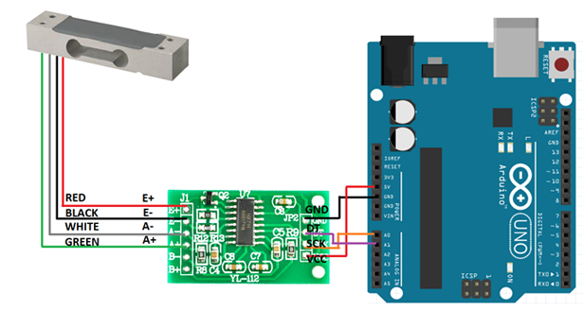
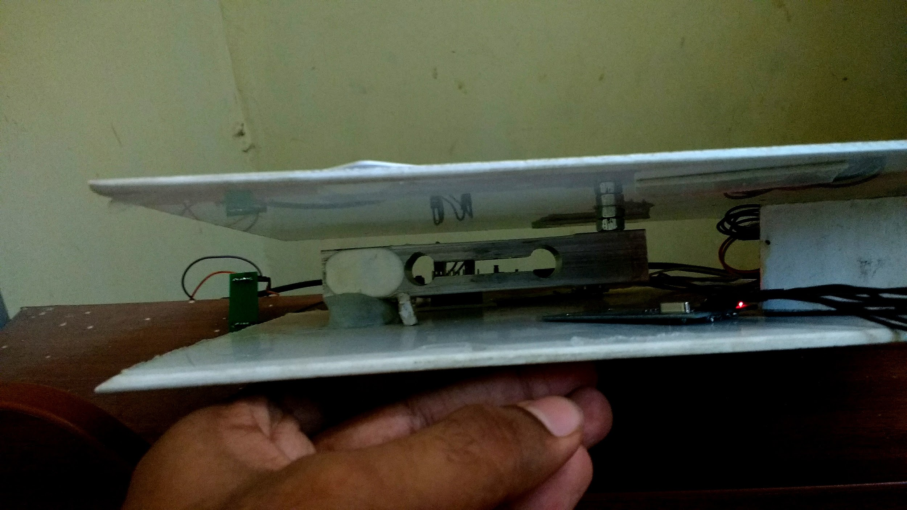

Slide 7
Innovation and Challenges
Innovations:
Platform design
Multiple rfid reader interfaces
Load sensor mechanical design
Challenges:
Load sensor readings The load sensor sends out analog signals so we need to take the readings after the value has reached equilibrium so we cannot take the readings at a high frequency hence we take the readings after every 5 seconds.
Load sensor calibration We could not calibrate the load sensor accurately because it requires using many different weights
Interfacing multiple rfid readers to R-Pi

Slide 8
Tasks
Make an RFID Reader work with R-Pi. Next make 2 RFID readers work with R-Pi using chip select pins Problems faced:
The RFID reader provided by lab didn’t work. We tested it meticulously by connecting it to laptop using USB-serial communicator. We ordered new RFID readers online
Interfacing multiple RFID readers to R-Pi using SPI interface
Interface load sensor to tiva-c. Send the weight reading to R-Pi using USB Problems faced:
Load sensor is connected to HX711 for ADC and amplification
Load sensor didn’t work with R-Pi due to some inherent timing issues so we had to use Tiva-C board to get the readings and then communicate them to R-Pi

Slide 9
Tasks
Code the UI on laptop. Run the python server on R-Pi to host the web page Problems faced:
None
Process the weight reading, rfid tag readings to output the weights of containers placed on the platform Problems faced:
Processing the data dumped by the readers was a challenge because we get the total weight of multiple containers and we had to see the changes in rfid to figure out individual weight of containers
Mechanical Part Problems faced:
Building the platform was a very hard challenge because the whole platform had to be balanced on the load sensor

Slide 10
Review
Test Plans:
Load sensor readings We calibrated the load sensor using a devised formula and tested it for different items
Multiple Rfid reader We meticulously checked the polling of readings by multiple rfid readers
Interface load cell to measure weight We interfaced the load cell connected to HX711 to TIVA as we had timing issues with using R-Pi and HX711 together
GUI with data visualization and alerts We have implemented both visualizations through graphs and alerts by highlighting containers that are running low in amount

Slide 11
Review
Performance metrics:
Load sensor readings The load sensor sends out analog signals so we need to take the readings after the value has reached equilibrium so we cannot take the readings at a high frequency hence we take the readings after every 5 seconds. This sampling frequency effects the overall performance by slowing speed down.
Load sensor calibration We could not calibrate the load sensor accurately because it requires using many different weights
Changes on the platform have to be made with a gap of 5 seconds. We want to reduce this delay as much as possible (future work).

Slide 12
Re-usability features
Our design is very modular. Code for load sensor and rfid reader interfacing is separate
You can change the rfid reader code, load sensor code, server code individually without affecting one another. The readings are exchanged mutually using ports or by reading/writing to a file
We adhered to the coding standards specified

Slide 13
Future enhancements
The user interface can be extended to be viewed from an Android/iOS mobile phone for the users’ convenience.
The platform can be made to accommodate a larger number of containers by using more load sensors and RFID readers.
Visiting the website requires the IP of raspberry which hasn’t been found automatically. We could customize the server to send a particular reply on particular request to pair the device with R-Pi without having to enter the IP
The mechanical design can be improved to make the platform sleek.
This product can be marketed in collaboration with other Smart-Kitchen and Modular-Kitchen platforms.
When a commodity is beyond a certain minimum quantity, the user can be alerted through SMS, or the application can place an order to the seller directly.

